Slide 1
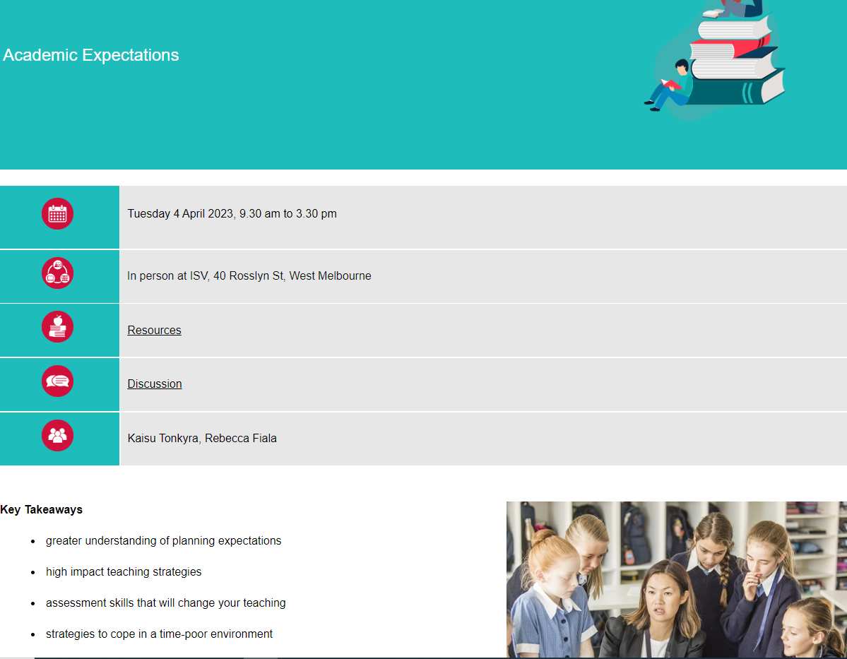
The Digital Companion
Track your learning
Access resources
Stay in touch

Slide 2
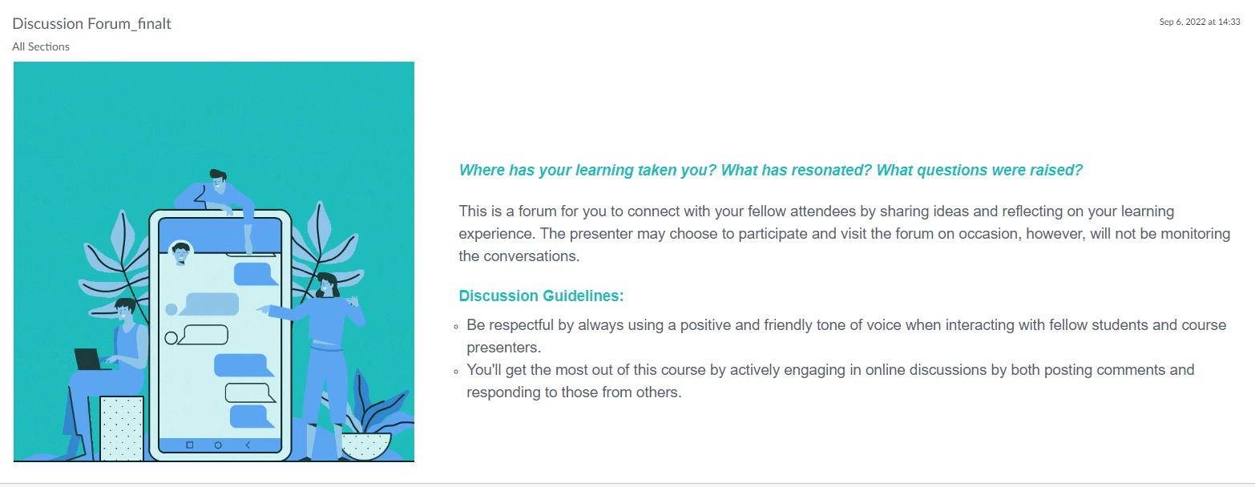
The Digital Companion
Continue to network with your fellow participants through the discussion space.

Slide 3
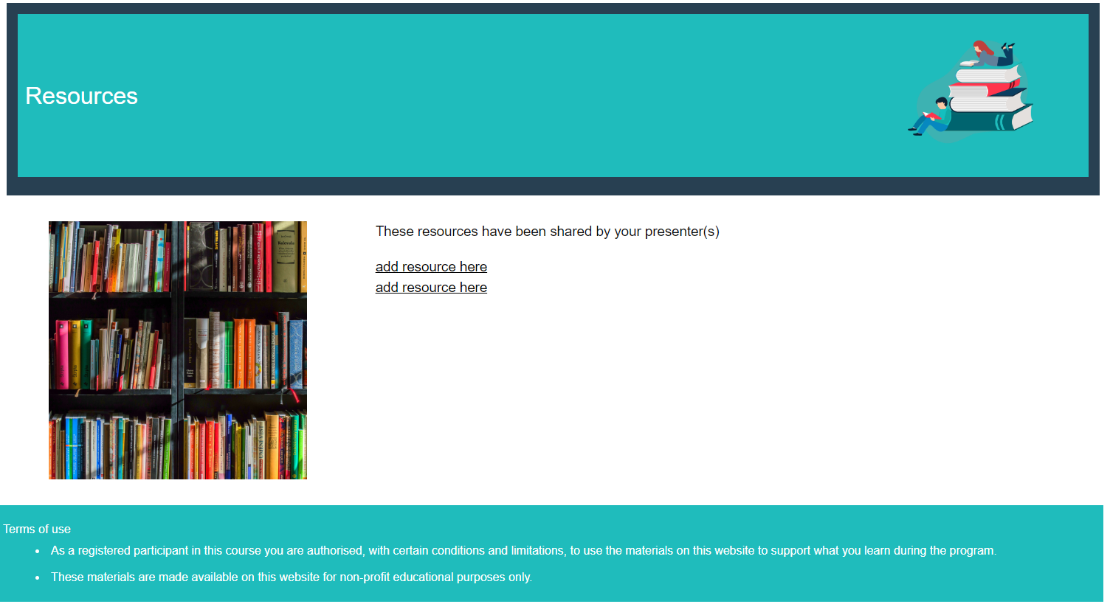
The Digital Companion
Access presenter resources and see related learning events.

Slide 4
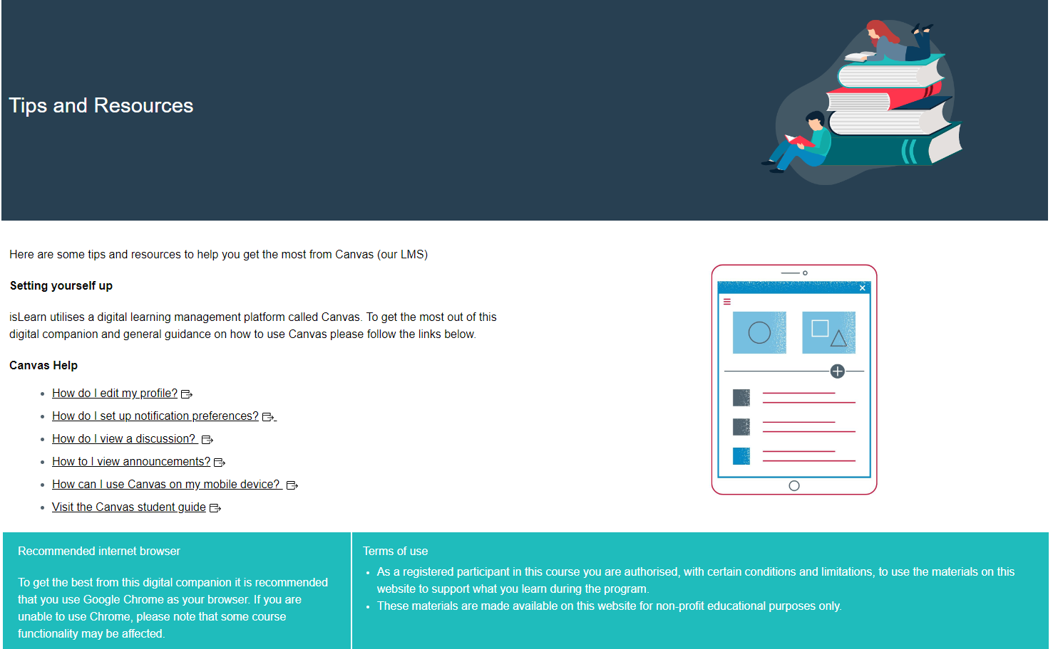
The Digital Companion
Find technical tips to enhance your Digital Companion experience.

